Slide 1
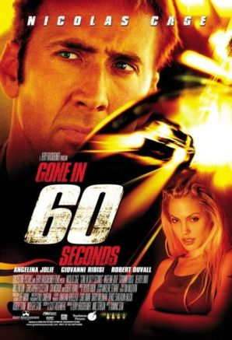



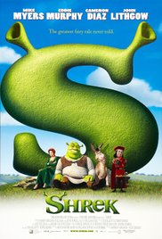
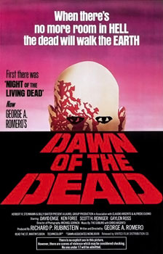
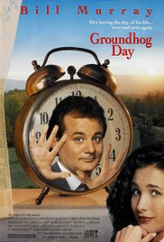

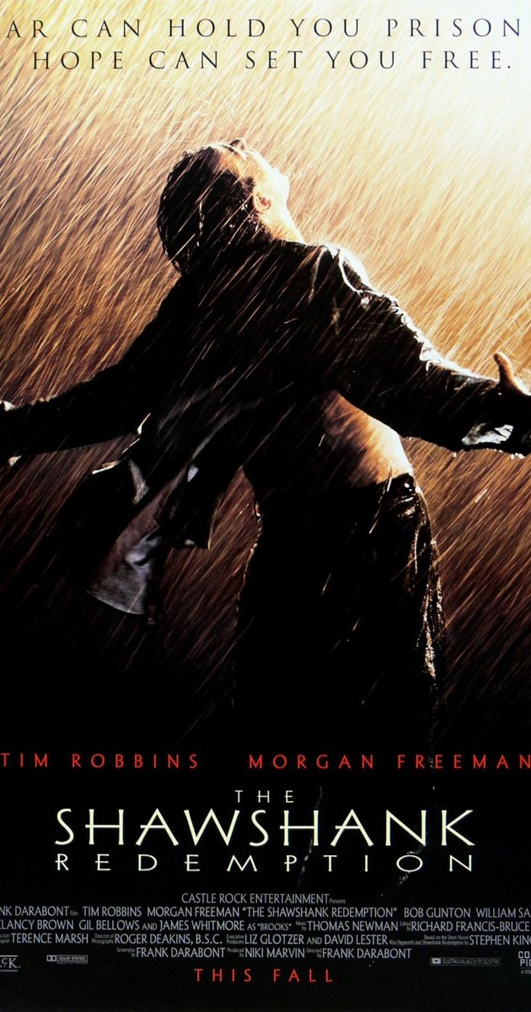
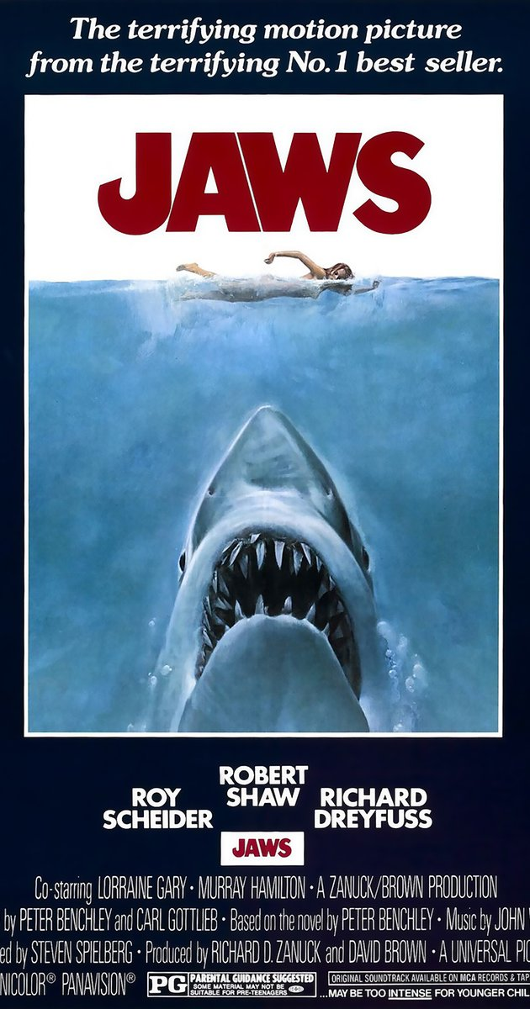
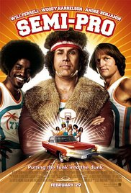
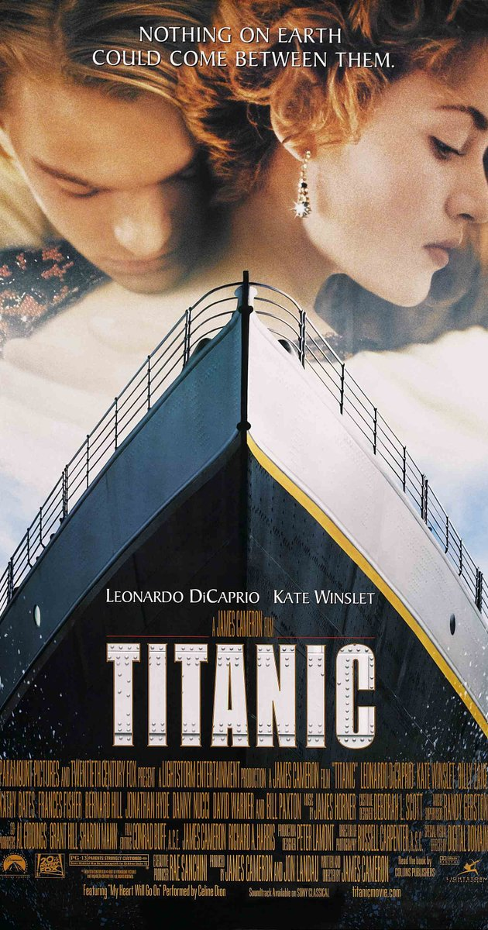
Data Mining in Movie Scripts
By: Michael Root

Slide 2
What I Did
Take 15 full movie scripts (mostly)
Analyze the words contained in them
Part-of-speech
Word count
Occurrence of phrases
Using:
Imsdb.com
Python
NLTK
Textmining-1.0
CSV of word occurrences was 80k lines
American Sniper
Dawn of the Dead 1977
Gone in 60 Seconds
Groundhog Day
Interstellar
Jaws
Legally Blonde
Life of Pi
Semi-Pro
Shawshank Redemption
She’s Out of My League
Shrek
The Last Samurai
The Revanant
Titanic

Slide 3
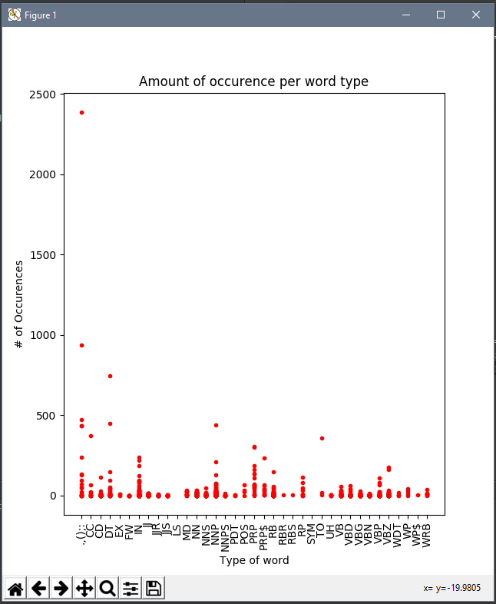
Results: Part-of-Speech
Singular Proper Nouns (NNP)
Over about 2500 total occurrences means the film focus on a few people
Prepositions (IN)
Words relating nouns to another element
Less than 1000 and you are not in a movie featuring a boat
Possessive Wh-pronouns (WP$)
If there are any WP$, there most likely is an interrogation scene
Interjection (UH)
Over 200 and you’re in a cartoon

Slide 4
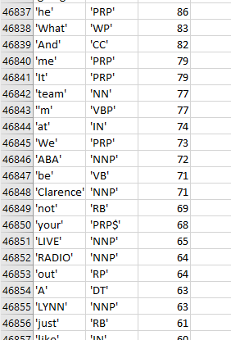
Word Occurrences
Mostly used for the graphs
Names of the main protagonists always occur within the top 15 most occurring words, usually within top 10
Punctuation marks are 2 of the top 3
Usually with ‘the’ in the mix
Nouns and verbs make up most of single word occurrences
Usually greater than 6 characters in length

Slide 5
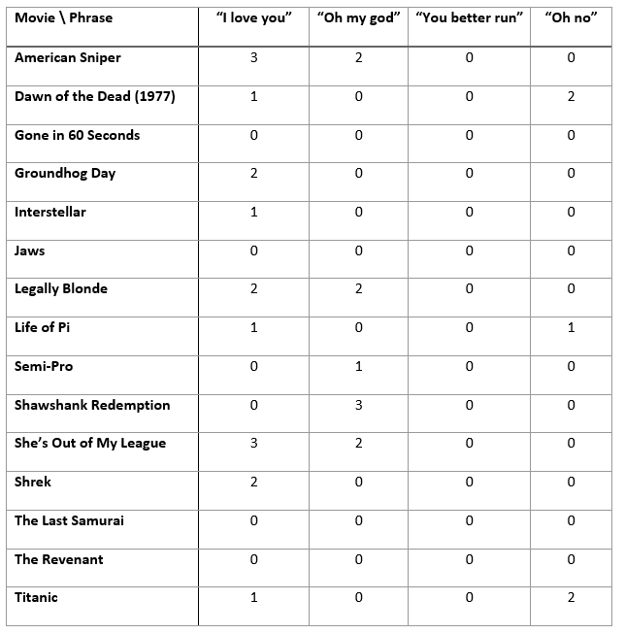
Common Phrases
Not as common as I expected
All variations included in the search

Slide 6
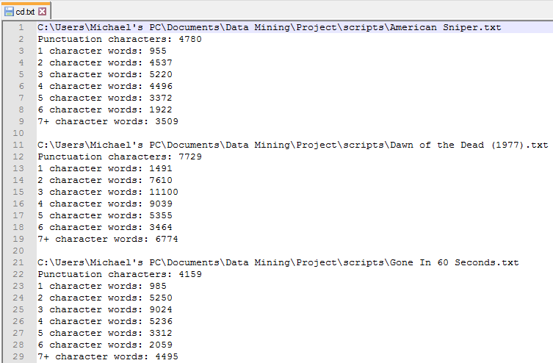
Character Amount
Writers like 3 character words
Single character words are always used the least
This shows the appearance of the POS graphs can distract observers

Slide 7
Conclusions
Hardest part was managing text files
1 text file of all the lines in all 15 movies was over 100k lines
CSV file of word occurrences was 80k
First CSV file was 3 gigs (via textmining-1.0) and took 30 minutes
Don’t trust graphs
A lot more movies are needed for more interesting information, but parsing in a lot of scripts can take a long time
Analyzing different aspects of movie scripts can tell you what kind of movie it is

